Slide 1
St Paul’s Bring ‘n Share Harvest Festival Lunch Sunday, 5th October 2014

Slide 2
The table is laden with food!

Slide 3
Lots of people contributed

Slide 4
Mmm..look at all the desserts!

Slide 5
Johanette wonders what to eat first

Slide 6
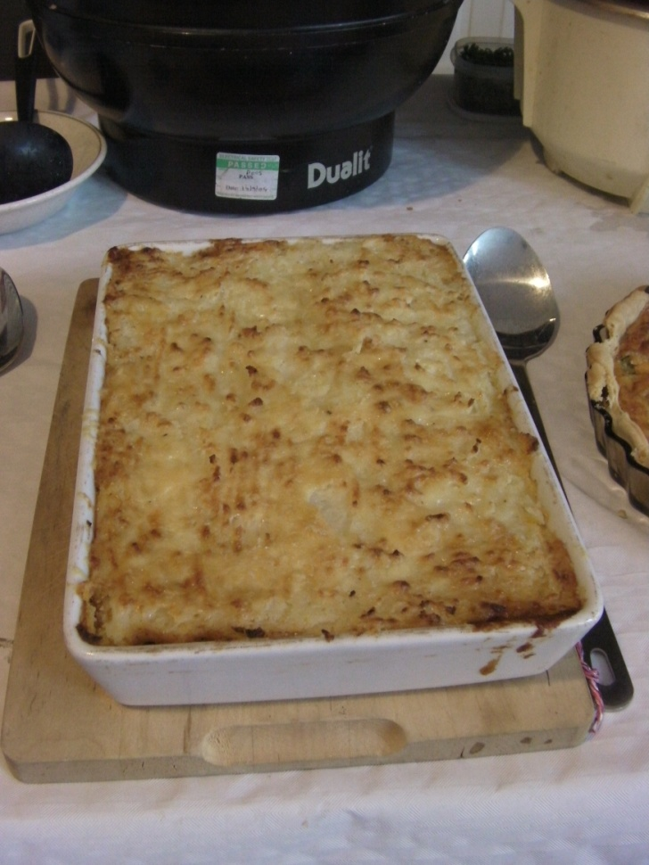
Chilli first, or shepherd’s pie?

Slide 7
The first hungry arrivals

Slide 8
Enjoying good food & fellowship

Slide 9
Kathy’s chilli grows cold while she runs around taking pictures!

Slide 10
Dawn & Carole chat over their meal

Slide 11
Ethan relaxes while Yit looks on

Slide 12
Johanette & Aurelia
looking really engrossed in something!

Slide 13
Emmanuel gets birthday wishes from the girls

Slide 14
Many thanks to everyone who helped to make the lunch an enjoyable success!

