Slide 1
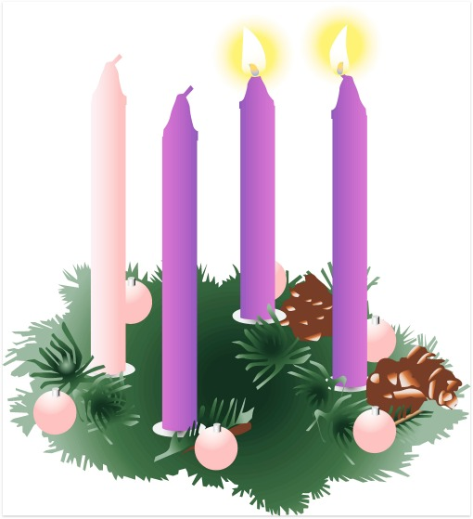
2014 Advent Bake Sale
held by the Swaziland Project
in aid of Swaziland

Slide 2
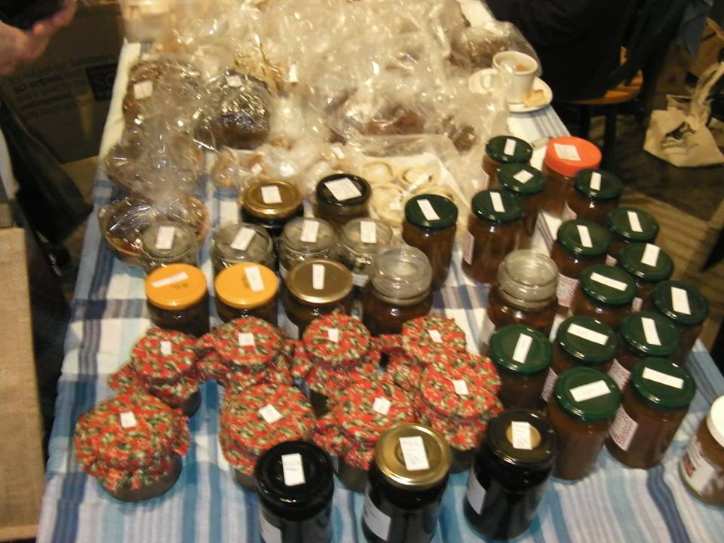
Taste-tempting goods baked or brought in by members of the congregation

Slide 3
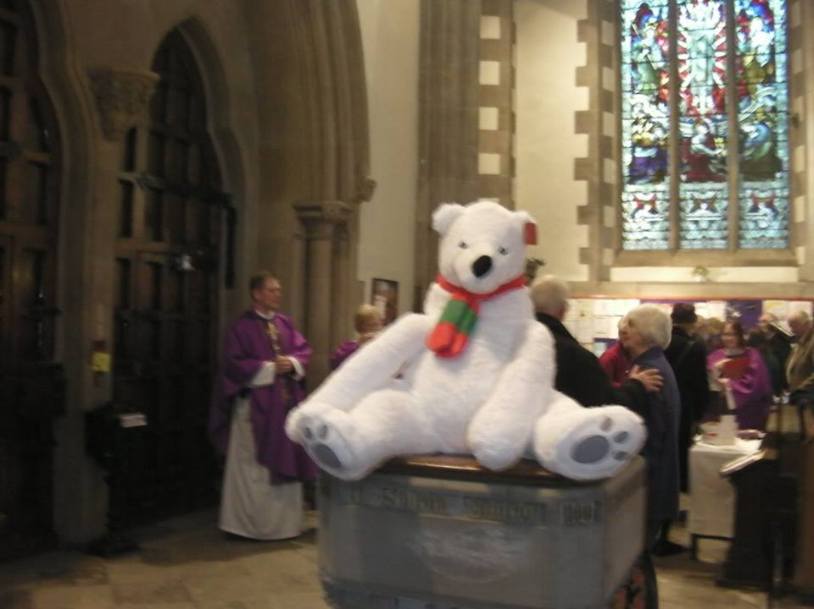
One of the many raffle prizes (the bear, not Jeremy!)

Slide 4
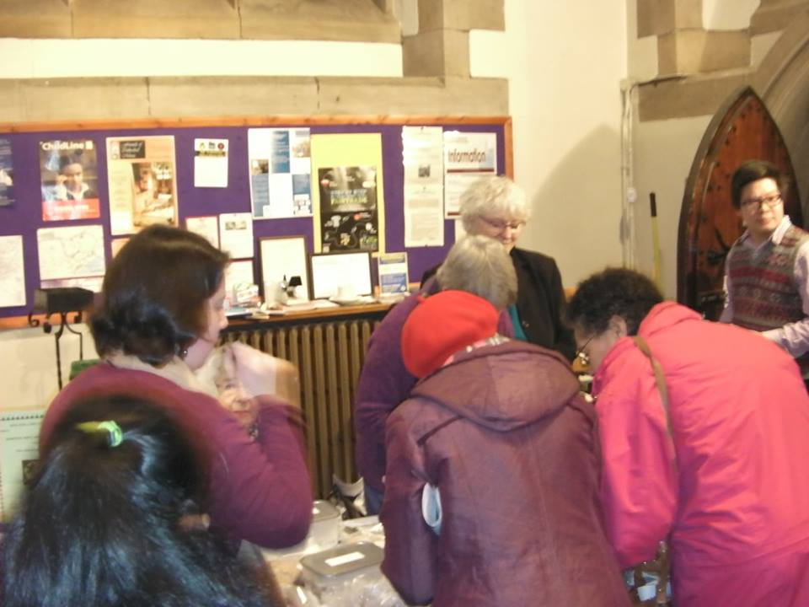
Swaziland project member Yvonne is all set to accept your money!

Slide 5
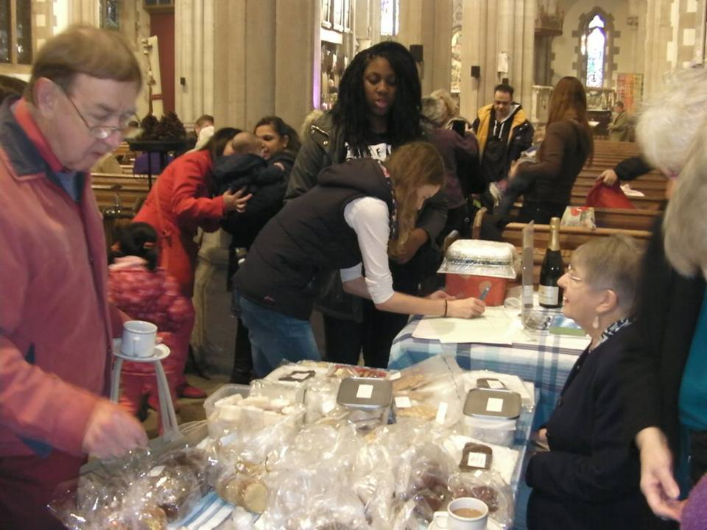
Terry tries to decide as Natasha & Elsa try to guess how many raisins are in Margaret’s cake

Slide 6
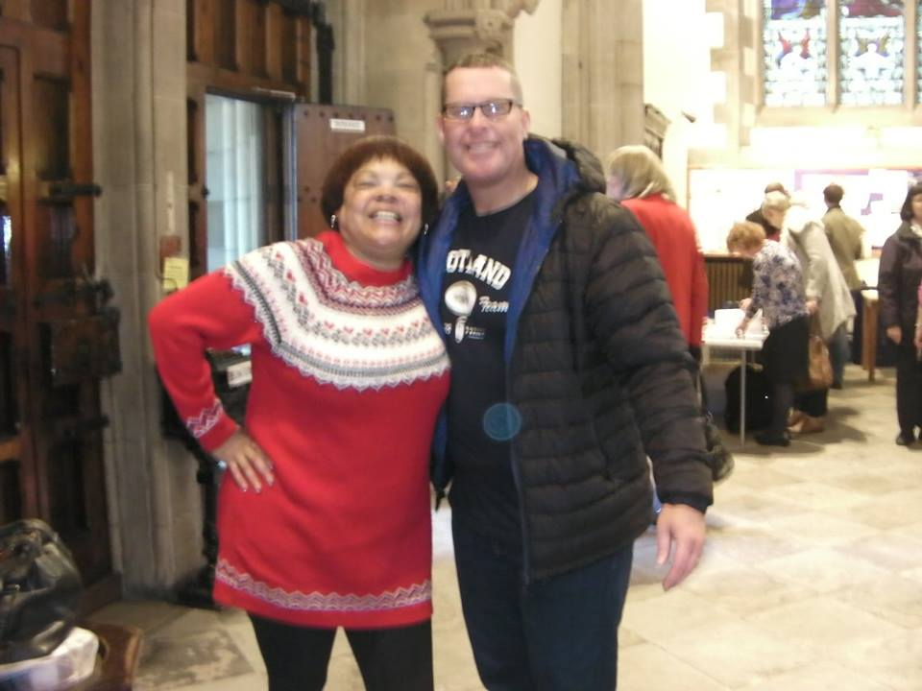
New Swaziland project members Kathy & Paul are so pleased with the way the bake sale is going!

Slide 7
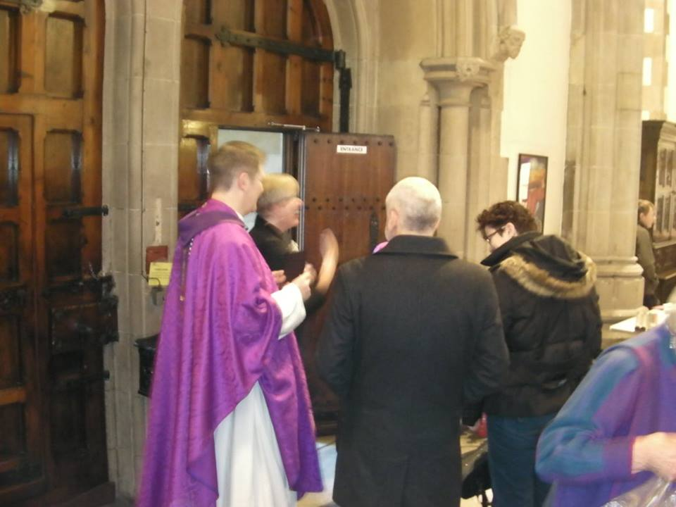
So hard to say goodbye after Sunday service...

Slide 8
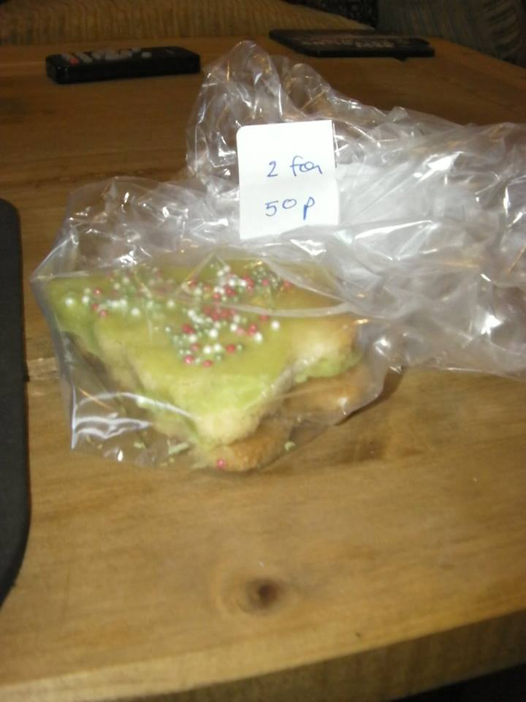
One of the contributors to the bake sale just couldn’t resist buying her own cookies!

Slide 9
£313.50 was raised in aid of Swaziland. Many thanks to everyone for taking part!

